Slide 1
Chapter 3
Displaying Data with Graphs and Charts

Slide 2
Learning Objectives
Describe the basic types of charts and graphs used in data visualization along with a specific purpose
Explain the types of scales required for preparing graphs and charts
Demonstrate the steps used in SPSS for executing the bar chart, line chart, pie chart, scatter plot, histogram, box plot and ogive
Explain the various subtypes of basic charts applicable to display more than one variable in a single graph
Demonstrate the use of the Chart Editor to make graphs more explanatory and effective

Slide 3
Creating SPSS Data Set
Executing Basic Charts and Graphs with SPSS
Simple Bar Chart
It is used when dealing with one variable based on nominal scale consisting of different categories and one variable measured at metric scale.
Exhibit 3.1. SPSS Windows » Open retail.sav » Menu bar » Graphs » Legacy Dialogs » Bar » Select Simple Bar chart » Select the option Other statistics » Select Price and transfer to first Variable box » Select Gender and transfer to Category Axis » Click OK

Slide 4
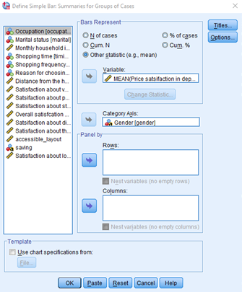
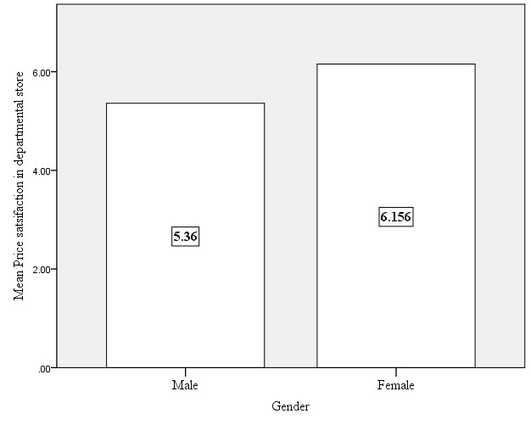
Exhibit 3.2. Double click on simple bar chart that appears» Chart Editor appears » use various options displayed in the chart editor » Double click on the chart editor » use various options of properties dialog box » Bar Option » Depth and angle » Variable » Chart size » Fill & Borders » Categories

Slide 5
Cluster Bar Chart
It is used to display the specific descriptors of a metric variable along with the respective categories of two nominal variables in the form of a cluster.
Exhibit 3.3. Use retail.sav » Menu bar » Graphs » Legacy Dialogs » Bar » Select cluster bar chart » Select the option Other statistics » Select Price and transfer to first Variable box » Select Gender and transfer to the Category Axis » Select Occupation and transfer to cluster box » Press OK

Slide 6
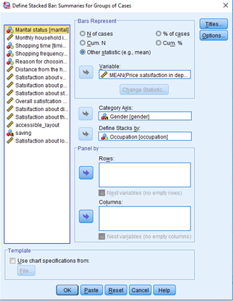
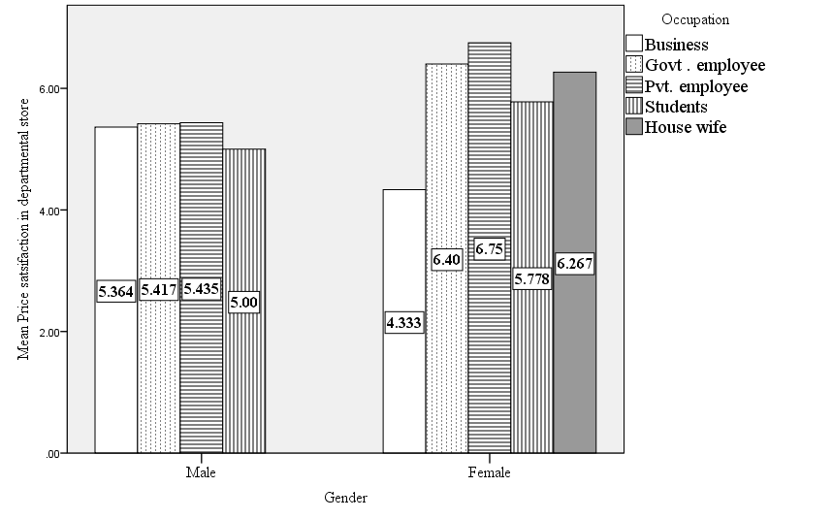

Slide 7
Stacked Bar Chart
This chart is used to display the specific descriptors of a metric variable along with the respective categories of two nominal variables in the form of different stacks rather than a cluster.
Exhibit 3.4. Use retail.sav » Menu bar » Graphs » Legacy Dialogs » Bar » Select stacked bar chart » Select the option Other statistics » Select Price and transfer to first Variable box » Select Gender and transfer to Category Axis » Select Occupation and transfer to Stacks box » Click OK

Slide 8
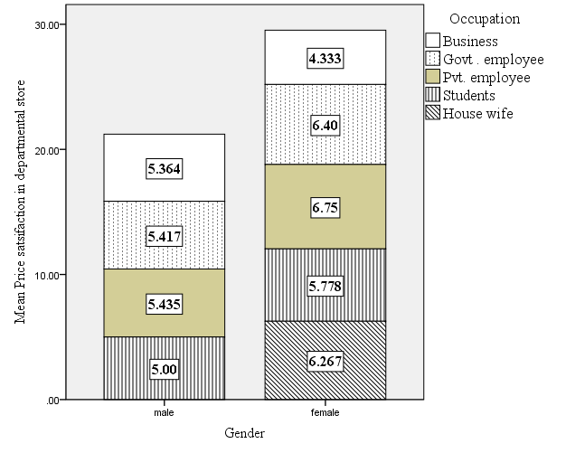

Slide 9
Simple Line Chart
This chart is most often used to display the time series data aiming to reveal a trend over a period of time. Generally, the independent variable or time is displayed at the x-axis, whereas the dependent variable appears at the y-axis.
Exhibit 3.5. Use retail.sav » Menu bar » Graphs » Legacy Dialogs » Line chart » Select Simple Line chart » Select the option Other statistics » Select Overall and transfer to first Variable box » Select Shopping time and transfer to Category Axis » Click OK

Slide 10
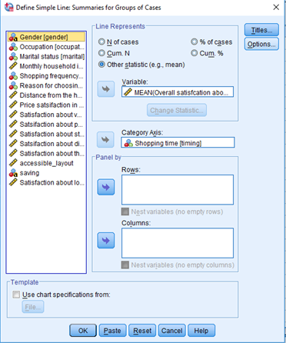
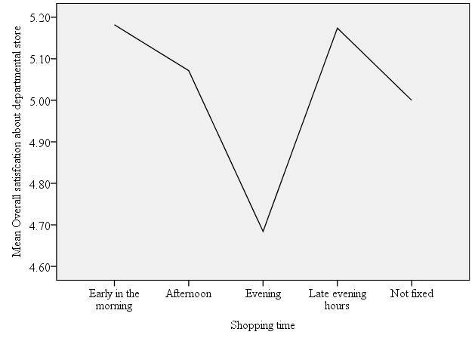

Slide 11
Multiple Line Chart
This chart is used to display the change in same measurement unit for distinct categories of two independent variables.
Exhibit 3.6. Use retail.sav » Menu bar » Graphs » Legacy Dialogs » Line chart » Select Multiple Line chart » Select the option Other statistics » Select Price and transfer to first Variable box » Select Gender and transfer to Category Axis » Select Occupation and transfer to Define Lines box » Click OK

Slide 12
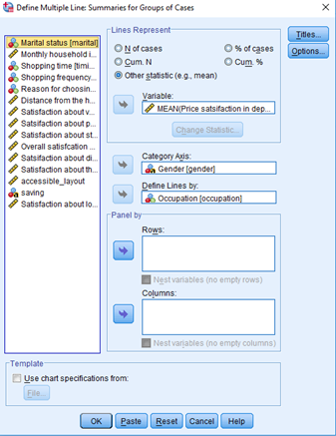
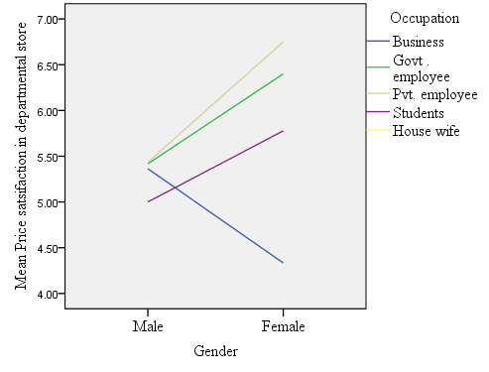

Slide 13
Pie Chart
This chart is used to display the relative proportion of data in the form of several pies or slices; hence, tit is also known as a round chart. Each slice in the chart presents the relative proportion of the specific variable.
Exhibit 3.7. Use retail.sav » Menu bar » Graphs » Legacy Dialogs » Pie chart » select the option N of cases (in Pie Represent section) » Select Occupation and transfer to first Define Slice By box » Click OK

Slide 14
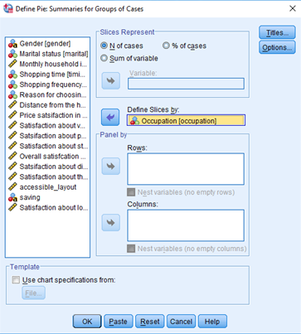
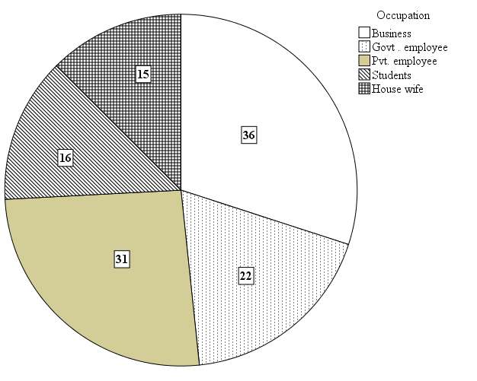

Slide 15
Simple Boxplot
Boxplot is a specialized chart to display the overall pattern of data distribution graphically. It is useful in visualizing the various characteristics such as shape of data distribution, skewness, kurtosis and presence of outliers in a data set.
Exhibit 3.8. Use retail.sav » Menu bar » Graphs » Legacy Dialogs » Boxplot » Select Simple Boxplot » Select Overall satisfaction and transfer to first Variable box » Select Gender and transfer to Category Axis box » Click OK

Slide 16
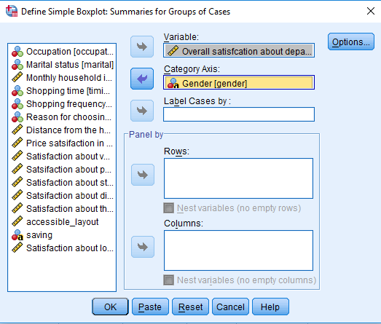
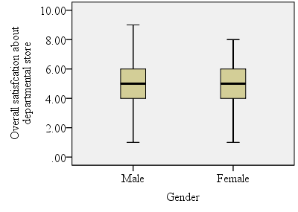

Slide 17
Clustered Boxplot
The clustered boxplot is more complex than the simple boxplot. It is used to visualize data distribution of one metric variable with respect to two independent variables in a single graph.
Exhibit 3.9. Use retail.sav » Menu bar » Graphs » Legacy Dialogs » Boxplot » Select Clustered Boxplot » Select Overall satisfaction and transfer to first Variable box » Select Gender and transfer to Category Axis box » Select Marital status and transfer to Define Clusters by box » Click OK

Slide 18
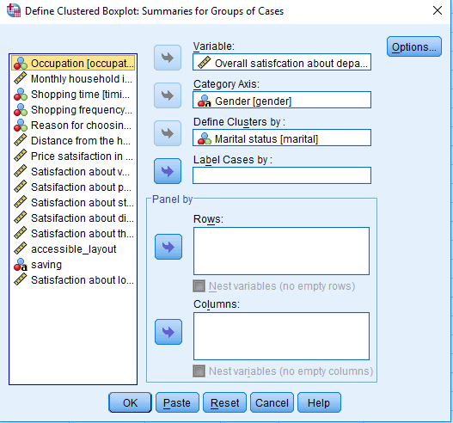
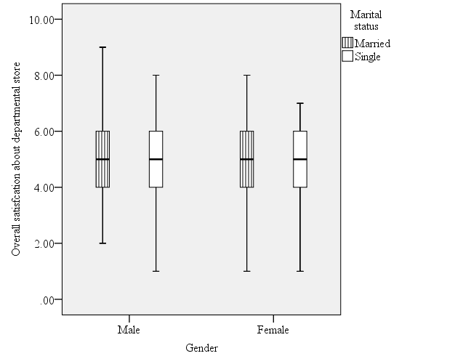

Slide 19
Simple Scatter Plot
Simple scatter plot presents linear correlation between two discrete or continuous variables. The variables measured at metric scale (interval or ratio) can be assigned at any of the axes (x or y) irrespective to their units, and the association is ascertained on the basis of a particular pattern that appears herewith.
Exhibit 3.10. Use multiplex.sav » Menu bar » Graphs » Legacy Dialogs » Scatter » Simple » Select visit_multiplex and transfer to Y Axis » Select Income and transfer to X Axis » Click OK

Slide 20
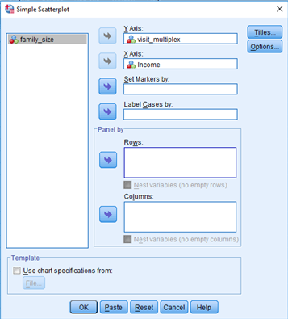
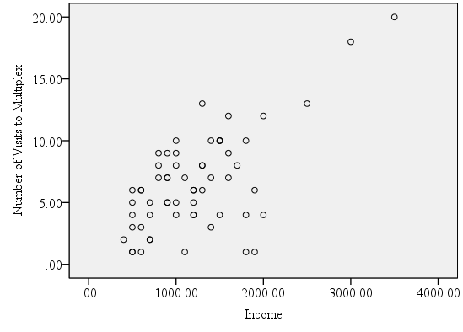

Slide 21
Matrix Scatter Plot
The matrix scatter plots are widely used to display the association among more than two variables simultaneously in a single chart at one point of time. The variables used in a matrix plot should be measured at the metric scale.
Exhibit 3.11. Use multiplex.sav » Menu bar » Graphs » Legacy Dialogs » Scatter » Matrix » Select visit_multiplex, Income and family_size transfer to Matrix Variables box » Click OK

Slide 22
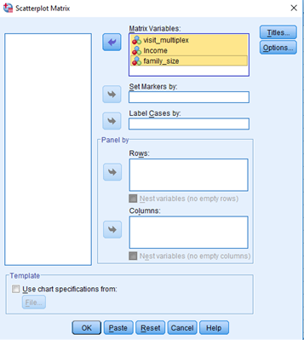
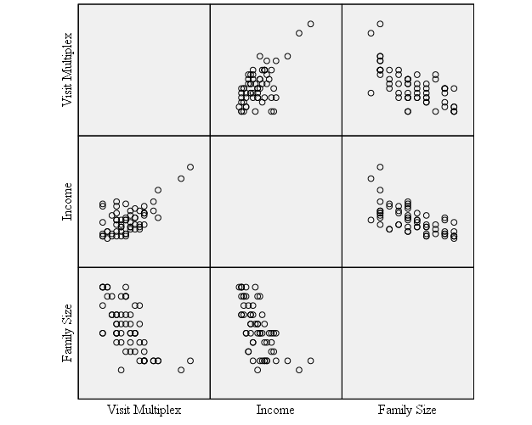

Slide 23
Histogram
A histogram is a specialized bar chart useful to portray frequency for a particular range or class interval. It is generally used to compute frequency of different categories in case of dealing with a large number of discrete or continuous data.
Exhibit 3.12. Use graduate.sav » Menu bar » Graphs » Legacy Dialogs » Histogram » Select CGPA and transfer to first Variable box » Click OK

Slide 24
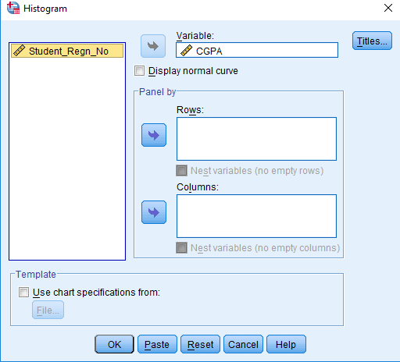
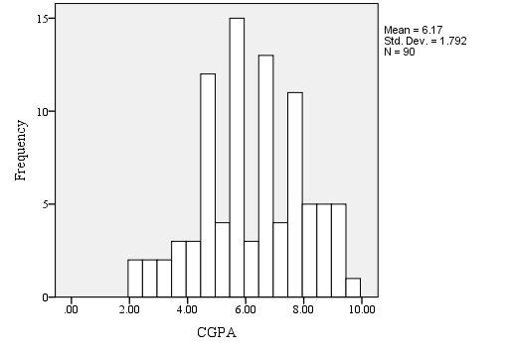
Exhibit 3.13. Double-click on the histogram chart » Chart Editor appears » Click on the horizontal axis (x-axis) » Properties box appears » select scale » Type 0.5 as major increment in range column » Press apply » Close the properties box and Chart Editor

Slide 25
Ogive (oh-jive)
This chart is used to display the cumulative frequencies of a particular variable measured at continuous or grouped data. It is also known as frequency polygon.
Exhibit 3.14. Use retail.sav » Menu bar » Graphs » Legacy Dialogs » Line chart » Select Simple » Define » Select Cum.N as Line Represents option » Select Distance and transfer to Category Axis » Click OK

Slide 26
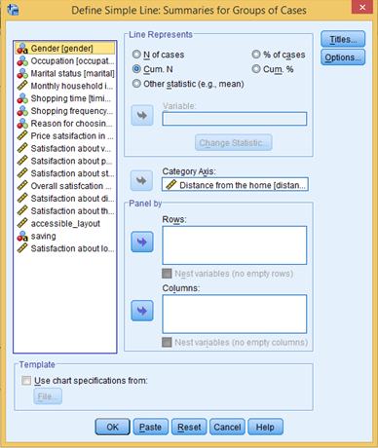
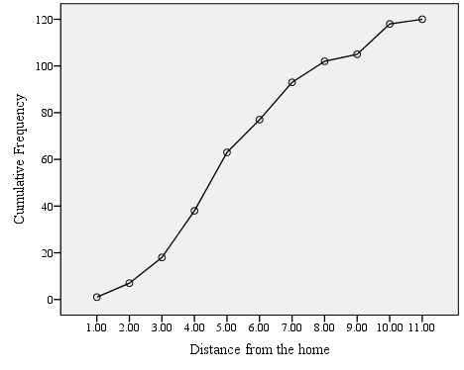

Slide 27
Requirements of Scale in Data Visualization
Chart | Category | Number of Variable(s) | Pattern of Display | Required Scale
Bar Chart | Simple Bar | 2 | Independent variable (1) on x-axis; Dependent variable (1) on y-axis | Independent variable: Nominal (with at least two categories) Dependent: Metric
 | Clustered Bar | 3 | Independent variables (2) on x-axis (One at category axis and one in cluster); Dependent variable (1) on y-axis | Both independent variables: Nominal (with at least two categories) Dependent: Metric
 | Stacked
Line Chart | Simple Line | 2 | Independent variable (1) on x-axis; Dependent variable (1) on y-axis | Independent variable: Nominal (with at least two categories) Dependent: Metric
 | Multiple Line | 3 | Independent variables (2) on x-axis (One at category axis and one in multiple lines); Dependent variable (1) on y-axis | Both independent variables: Nominal (with at least two categories) Dependent: Metric
Pie Chart | Pie Chart | 2 | Independent variable (1) appears as slices corresponding to dependent variable (1) | Independent variable: Nominal based multiple category Dependent: Metric
Boxplot | Simple Plot | 2 | Box plot of dependent variable (1) appears equals to the categories of independent variable (1) | Independent variable: Nominal (with at least two categories) Dependent: Metric
 | Clustered Boxplot | 3 | Box plot of dependent variable (1) and independent variables (2) on x-axis (One at category axis and one in clustered form); | Both independent variables: Nominal (with at least two categories) Dependent: Metric
Scatter Plot | Simple plot | 2 | Both variables appear between horizontal (x-axis) and vertical (y-axis) | Both variables based on metric scale
 | Matrix plot | More than 2 | All possible pairs of variable appears in table of several scatter plots | All variables based on either interval or ratio scale
Histogram and Ogive | Simple Histogram | 1 | Dependent variable (1) appears on y-axis | Dependent variable: Metric

Slide 28
Key Terms
Chart Editor Clustered bar chart Clustered box plot Histogram Matrix Scatter plot Multiple line chart Ogive chart | Pie chart Scatter plot Simple bar chart Simple box plot Single line chart Stacked bar chart

